Slide 1
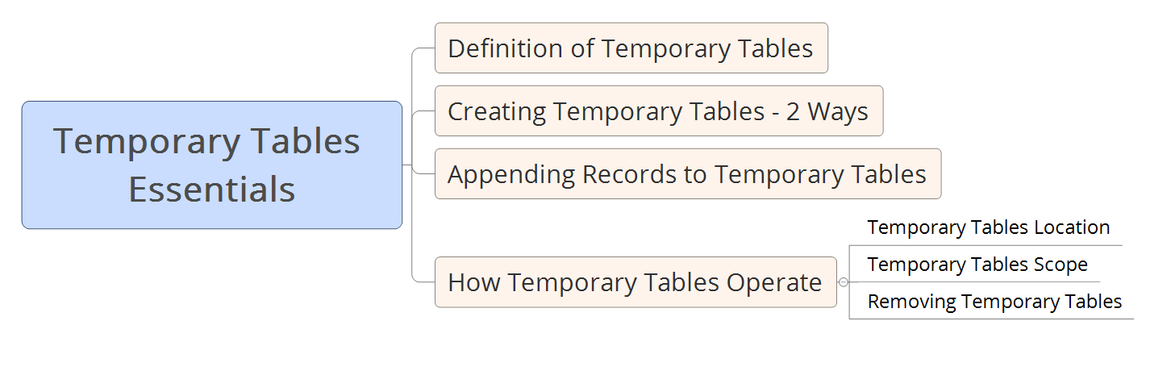

Takeaways
Notes:
In this section of the course, we are going to study all about using variables in SQL Server
We are going to discuss the basics of using variables.
I will show you the three main things you will need to be able to do
When working with variables
Those three main things are:
Declaring variables
Giving a value to a variable
And referencing a variable in a query
Then we will proceed to study specific uses for variables in SQL Server
I will show you how to store query results in variables
And how to exhibit those values you stored in variables using either print or select statements
We will practice how to refer to a single record in variables and how to gather values in variables
Finally, we will talk about global variables, and how useful they are in retrieving system information
So, see you in the next video.

Slide 2
What are Temporary Tables
Notes:
In this section of the course, we are going to study all about using variables in SQL Server
We are going to discuss the basics of using variables.
I will show you the three main things you will need to be able to do
When working with variables
Those three main things are:
Declaring variables
Giving a value to a variable
And referencing a variable in a query
Then we will proceed to study specific uses for variables in SQL Server
I will show you how to store query results in variables
And how to exhibit those values you stored in variables using either print or select statements
We will practice how to refer to a single record in variables and how to gather values in variables
Finally, we will talk about global variables, and how useful they are in retrieving system information
So, see you in the next video.

Slide 3


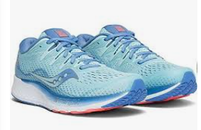

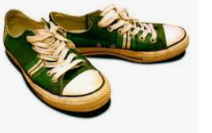

Notes:
In this section of the course, we are going to study all about using variables in SQL Server
We are going to discuss the basics of using variables.
I will show you the three main things you will need to be able to do
When working with variables
Those three main things are:
Declaring variables
Giving a value to a variable
And referencing a variable in a query
Then we will proceed to study specific uses for variables in SQL Server
I will show you how to store query results in variables
And how to exhibit those values you stored in variables using either print or select statements
We will practice how to refer to a single record in variables and how to gather values in variables
Finally, we will talk about global variables, and how useful they are in retrieving system information
So, see you in the next video.

Slide 4
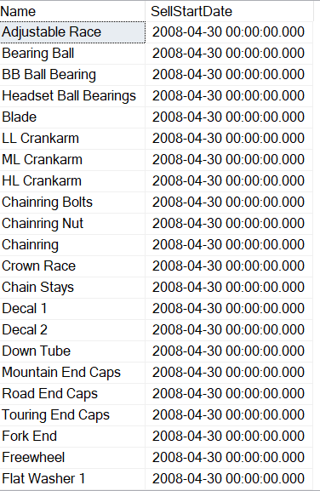
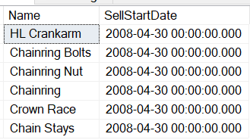

Notes:
In this section of the course, we are going to study all about using variables in SQL Server
We are going to discuss the basics of using variables.
I will show you the three main things you will need to be able to do
When working with variables
Those three main things are:
Declaring variables
Giving a value to a variable
And referencing a variable in a query
Then we will proceed to study specific uses for variables in SQL Server
I will show you how to store query results in variables
And how to exhibit those values you stored in variables using either print or select statements
We will practice how to refer to a single record in variables and how to gather values in variables
Finally, we will talk about global variables, and how useful they are in retrieving system information
So, see you in the next video.

